Slide 1
Kidney Stones

Slide 2
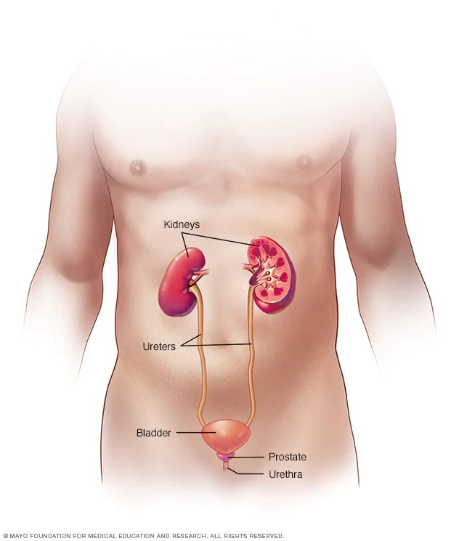
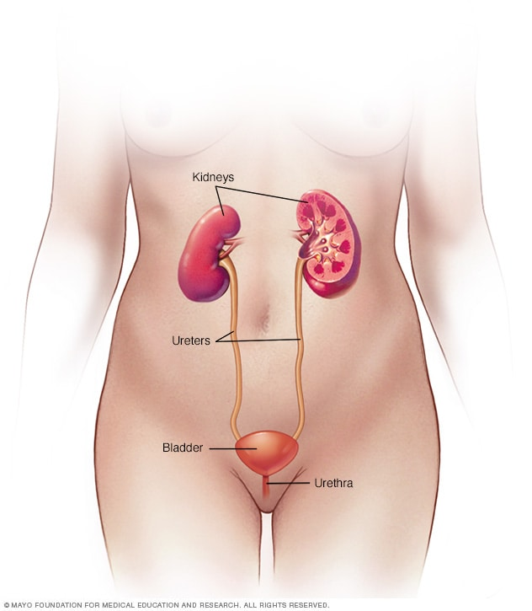
Female Urinary System
Male Urinary System

Slide 3
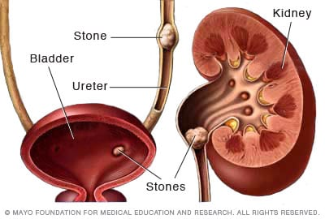
What are kidney stones?
Kidney stones (also called renal calculi, nephrolithiasis or urolithiasis) are hard deposits made of minerals and salts that form inside your kidneys.
Kidney stones form in your kidneys. As stones move into your ureters (the thin tubes that allow urine to pass from your kidneys to your bladder).
Signs and symptoms of kidney stones can include severe pain, nausea, vomiting, fever, chills and blood in your urine.

Slide 4
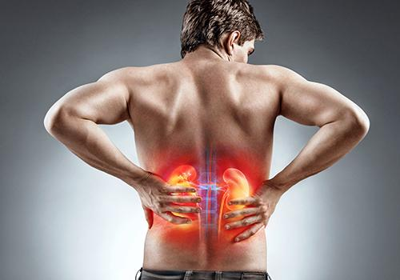
Types of kidney stones
Calcium stones: Most kidney stones are calcium stones,
usually in the form of calcium oxalate.
Struvite stones - form in response to a urinary tract infection.
Uric Acid stones: Can form in people who lose too
much fluid because of chronic diarrhea or malabsorption.
Cystine stones: These stones form in people
with a hereditary disorder called cystinuria that
causes kidneys to excrete too much of a specific amino acid.
https://www.mayoclinic.org/diseases-conditions/kidney-stones/symptoms-causes/syc-20355755

Slide 5
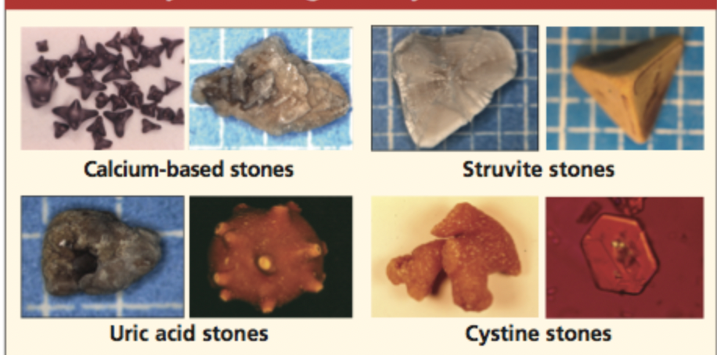

Slide 6
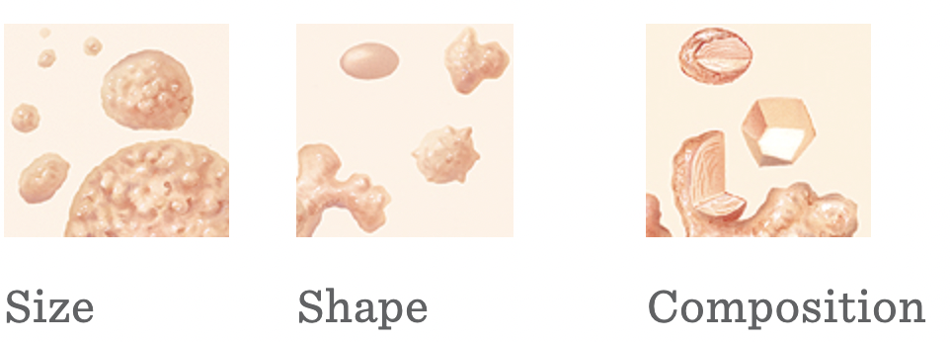
What to look for when
you see a kidney stone
Can the stone pass?
https://www.saintlukeskc.org/health-library/identifying-kidney-stones

Slide 7
Questions About Imaging Tests To Check for Kidney Stones
Question | Ct Scan | Ultrasound
What is it? | A CT scan uses x-rays and computers to create three dimensional pictures of your urinary tract (kidneys, ureters, and bladder). | An ultrasound uses sound waves to create a picture of your kidneys and bladder. It is like the ultrasound used to look at the baby in the womb of a pregnant woman.
How is it done? | You lie still on a table that slides into a tunnel-shaped machine. A CT scan does not hurt. | You lie on your back or side, and a health care professional moves a small device around on your belly. An ultrasound does not hurt.
Does it expose you to radiation? | Yes, a CT scan exposes you to radiation. Radiation raises the risk of getting cancer. | No, an ultrasound does not expose you to radiation.
Notes:
https://effectivehealthcare.ahrq.gov/products/kidney-stone-imaging/consumer

Slide 8
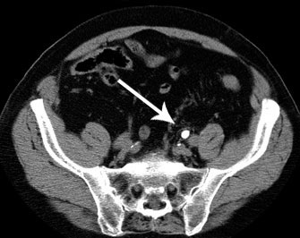
CT Scan
L
Notes:
Kidney stone attached to Left kidney

Slide 9
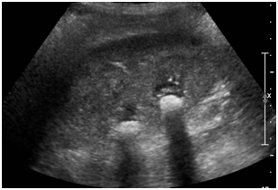
Ultrasound - female with multiple kidney stones

Slide 10
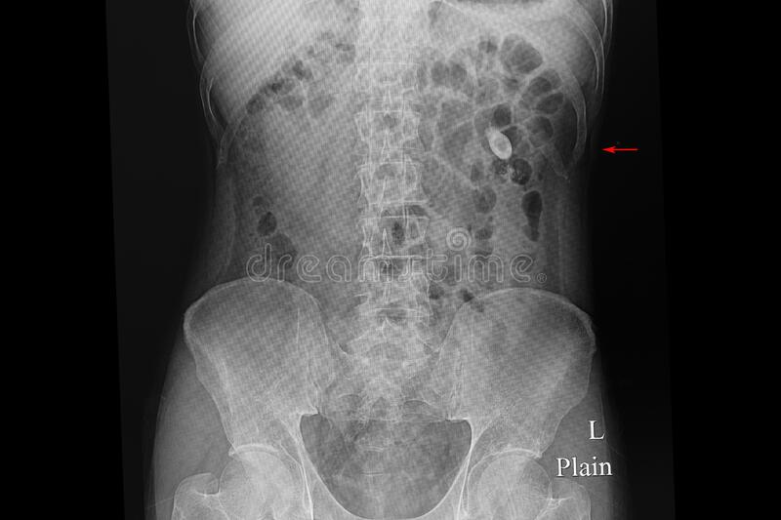
Xray- used less frequently than CT scans

Slide 11
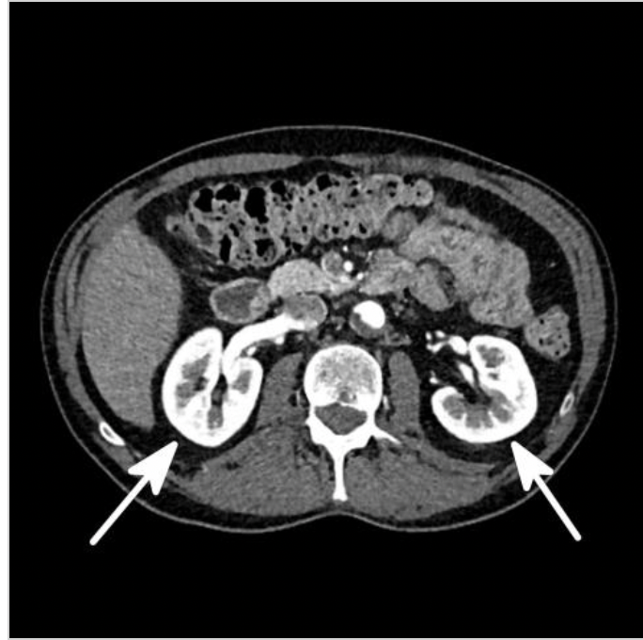
CT Scan of Kidneys
https://kidneystonemelbourne.com.au/diagnosis/investigations/imaging

Slide 12
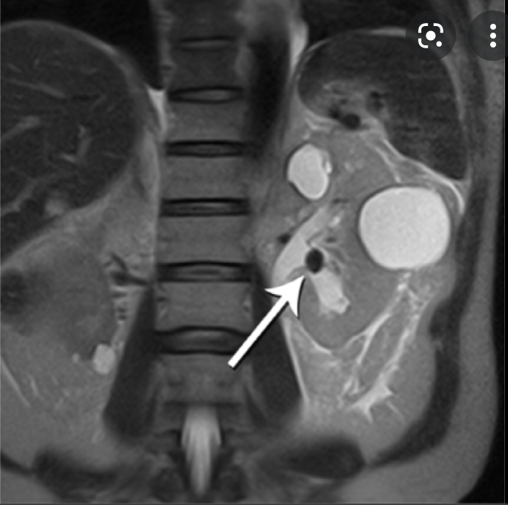
MRI of Kidney Stones

Slide 13
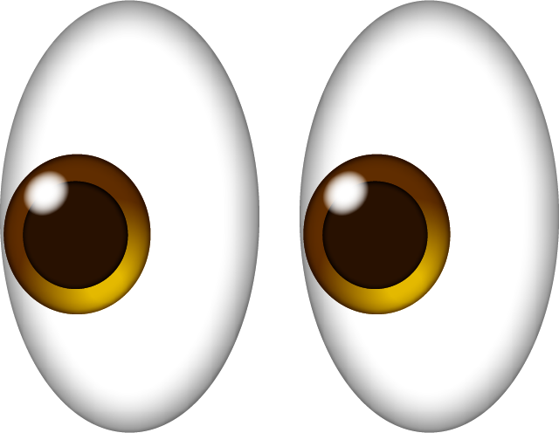
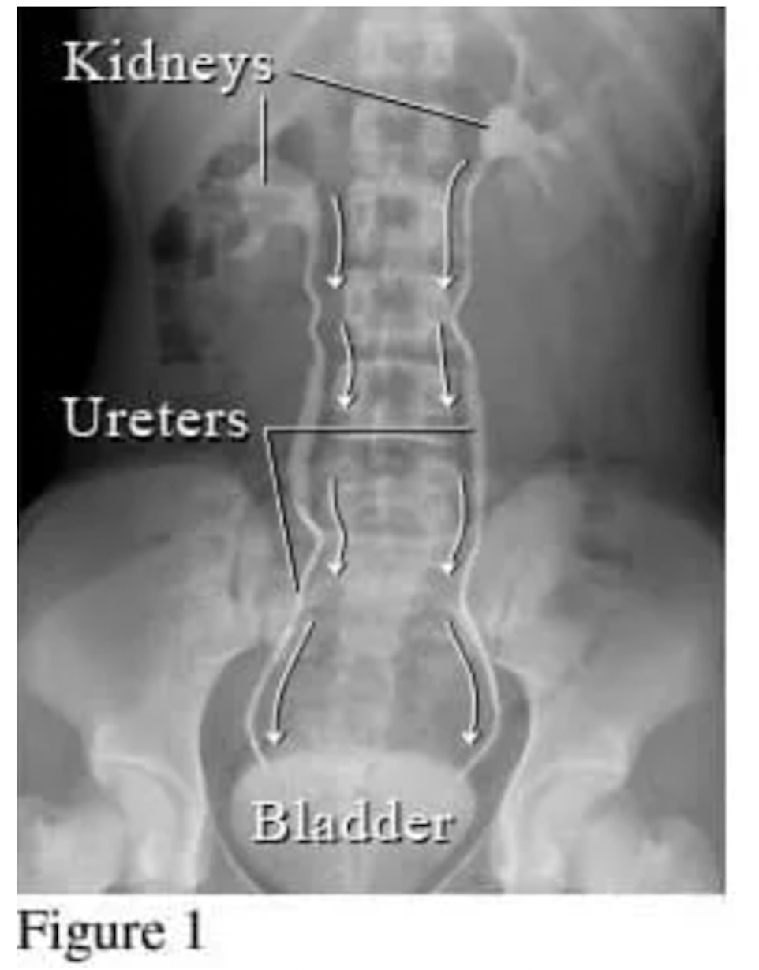
WHAT ARE WE LOOKING AT ?
CT Scan?
MRI?
X-Ray?
Ultrasound?

Slide 14
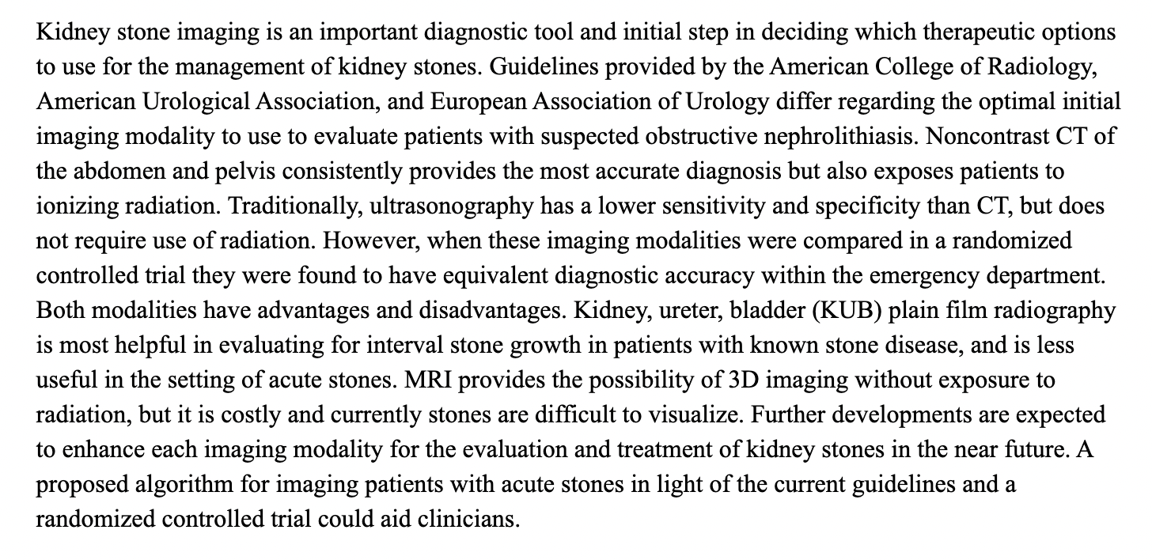
As a future PA, do I do a CT, MRI or Ultrasound?

